Slide 1
Remote Labs Suggested Changes

Slide 2
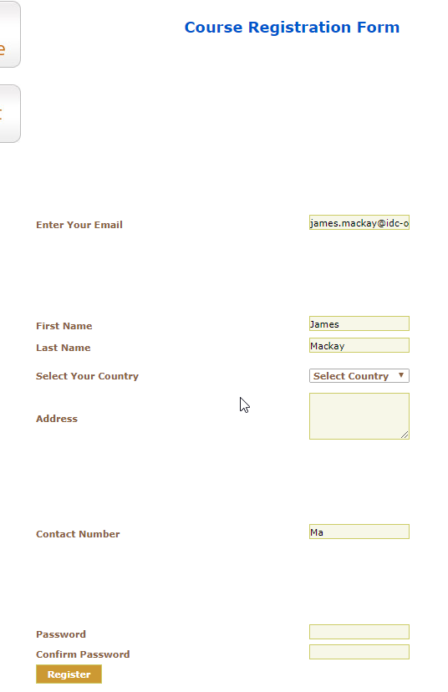
Registration Form
Issue/Fix
Screenshot
The registration form isn’t appealing to look at. The tab order is also a mess.
Complete redo of the form. Assuming this will be embedded on the new Electromeet website.

Slide 3
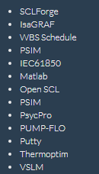
Homepage Description
Issue/Fix
Screenshot
Dot points needed to be added to the options available for a lab.
Before
After

Slide 4
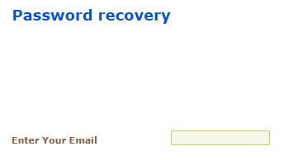
Password Recovery
Issue/Fix
Screenshot
Another page isn’t necessary. Selecting ‘Password recovery’ should simply send an email to the user with the updated details.

Slide 5
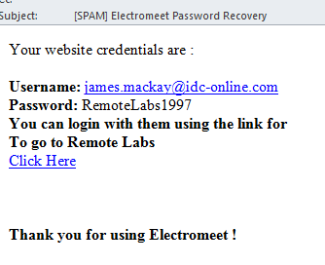
Email Received
Issue/Fix
Screenshot
Remove ‘[SPAM]’ from the subject line.
Change the bottom text to ‘Thankyou for using our Remote Labs’.

